Slide 1


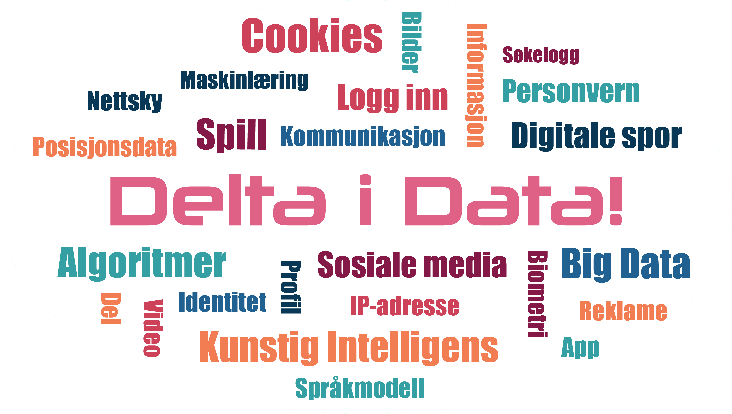
DataDelta & Data Iceberg
Notes:
Teaching plan for 2x45 minutes with games and assignments: https://edutrust.slateresearch.ai/game-package

Slide 2

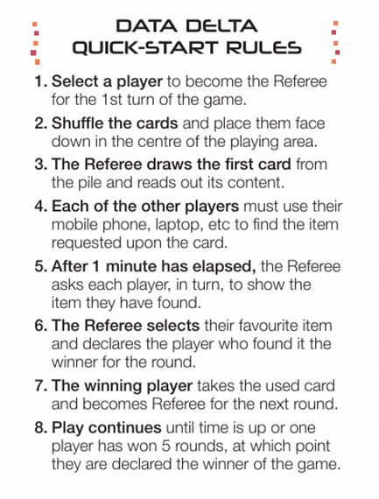





PLAN (2 x 45 min)
1 - DataDelta
  Introduction and Rules (5 min)
  Play DataDelta (30 min)
  Discussion and tasks (10 min)
  What is data? How is data created?
  Collaborate on searches
2 – Data Iceberg
  Introduction (10 min)
  4 types of data (with examples)
  Rules for Data Iceberg
  Play Data Iceberg (30 min)
  Discussion and more examples (5 min)

Slide 3
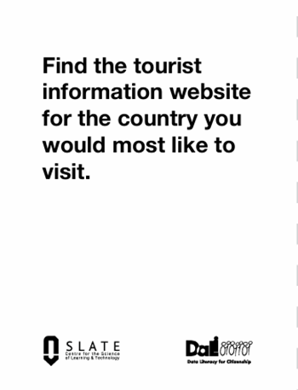
DATA DELTA RULES
4-6 players
30-40 minutes
54 cards
Chose a Referee for the first round, and shuffle the cards
1. The Referee picks a card and reads it out loud.
2. The other players uses their phone to find what the card asks for.
3. After 1 minute each player share what they have found
4. The Referee chooses their favourite answer and announces the winner of the round.
5. The winner of the round gets the card, and then becomes the referee for the next round. Or: Let the players take turns in being the Referee.
6. The winner of the game is the player with the most cards

Slide 4
PLAY DATA DELTA
Digital version:
https://datadelta.slateresearch.ai/#/
PDF for print: https://edutrust.slateresearch.ai/datadelta

Slide 5
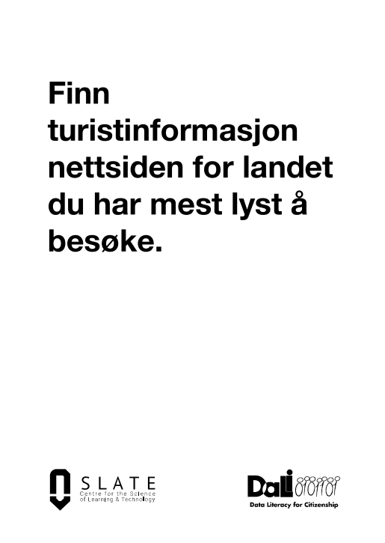
DATA DELTA DISCUSSION
Group assignment 1: Discuss
Which search engines and apps did you use?
Did you accept ‘Cookies’?
What data did you share? (For example: what search words did you use?)
Go to your phones app store and choose an app that you used. Look under ‘data security’ and ‘Collected data’. What types of data does the app say it collects?
Datatyper: Google

Slide 6
DATA DELTA DISCUSSION
Group assignment 2: Collaborate on searches
Everyone in the group searches with exactly the same words in the same search engine. Compare the results.
Then, use the same search words in different search engines (Such as Google, DuckDuckGo, Bing/Copilot). Compare the results.
Discuss: What does the result look like? Does the same result and sequence appear for all players? Why/why not?
Feel free to search several times (for, for example, clothing, travelling, recipes, etc.)
A brief description of some search engines

Slide 7

Data Iceberg
What is data?
What types of data exist?
Visible data
?
?
?
?
Invisible data

Slide 8


Human-created data
Human-created data
Without digital tools
For example
You draw ideas for a TikTok video with a pencil
Photo: DALL-E
Notes:
Human-created data: Data that is created without digital tools

Slide 9





Raw data
Raw data: Content
Raw data: Sensor
Visible and unprocessed data created intentionally by humans.
For example
You type your date of birth to register a TikTok profile.
You also upload a video of your cat.
Invisible data recorded by a sensor.
For example
The GPS-sensor on your phone records your location when you use the TikTok app.
Bilete: DALL-E
Bilete DALL-E
Notes:
Raw data: When people use digital machines, for example when we type a search word on the internet, we «give» data to the machine. This type of data (content, sound, text, images, sensordata) is not (yet) analysed/processed for a specific purpose, which is why we call it raw data.
The search words used while playing the preveous game is also raw data.

Slide 10




Analytical data
Analytical data: Visible
Analytical data: Invisible
Data is collected and used by the system, and is shown back to you
For example
The number of times your TikTok videos have been viewed or shared is collected and made visible for you and others.
Data that is collected and used by the system but is invisible to you.
For example
TikTok records how long you watch a cat video and shares this information with others, without showing it to you.
Photo: DALL-E
Notes:
Analysed (analytical) data: Log files and metadata (‘data about data’) that is created as a ‘side effect’ when you interact with digital devices

Slide 11



Functional data
Functional data
Data that is necessary for machines to communicate with each other
Functional data allows videos from TikTok to stream smoothly to your mobile phone.
For example
Buffering information and the data packages needed to ensure that the video plays without interruption
Also: IP-adresse
Bilete: DALL-E
Notes:
Data that is needed for an app or website to work

Slide 12
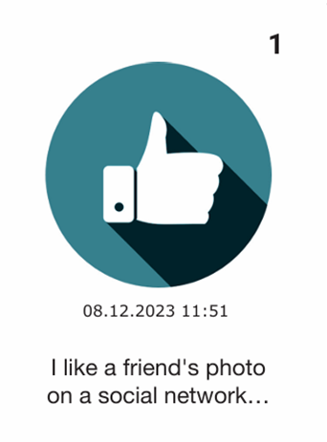
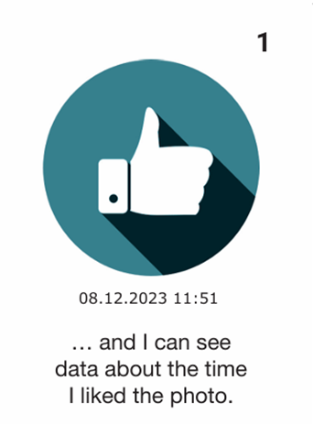
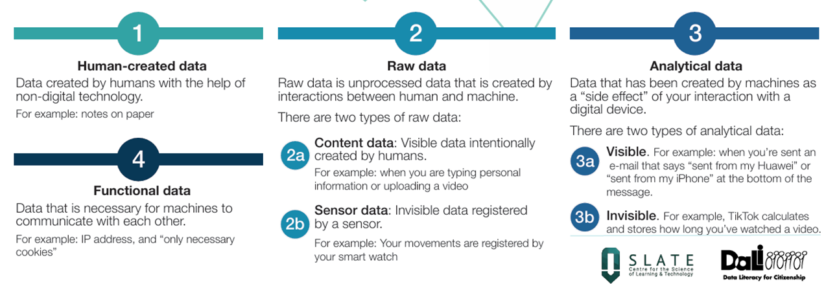
Data Iceberg
EXAMPLE
?

Slide 13
Visible
data
Data Iceberg
Human-created data
Raw data: Content
Analytical data: Visible
Raw data: Sensor
Analytical data: Invisible
Invisible data
Functional data

Slide 14

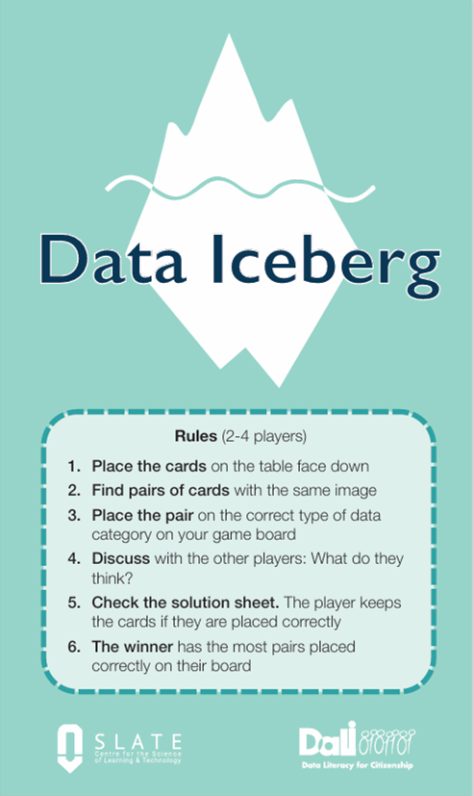
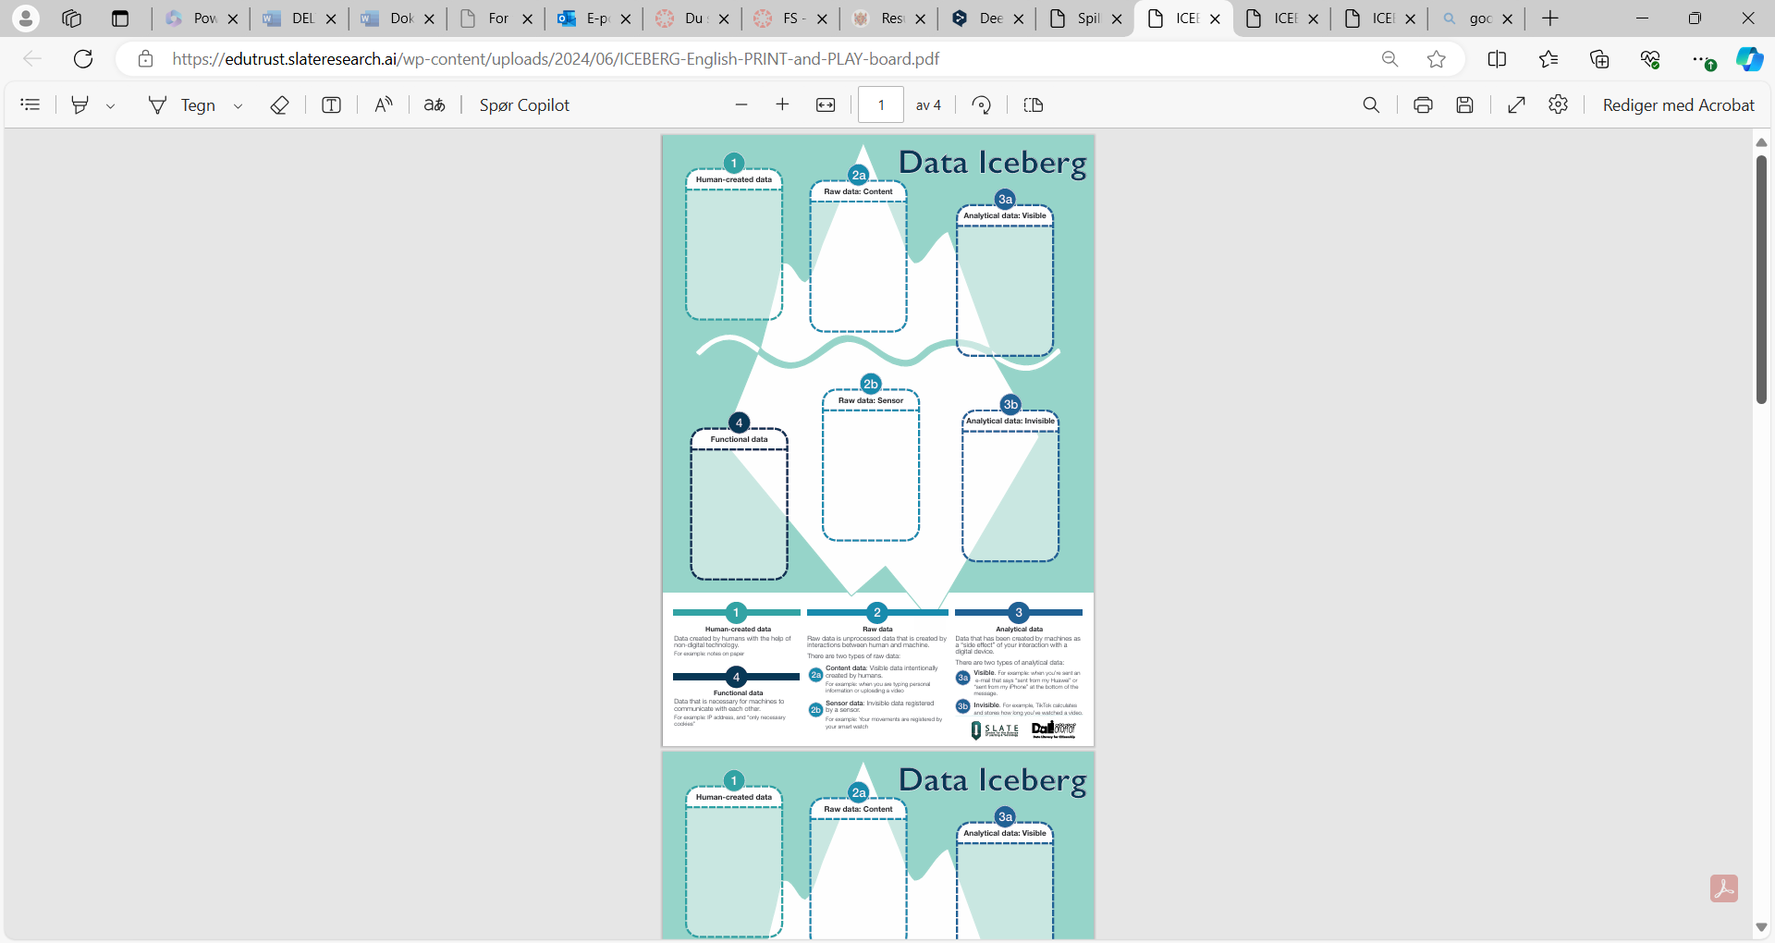
Setup for 4 players

Slide 15
2-4 players
30-45 minutes
Data Iceberg RULES
1. Spread the cards on the table picture down.
2. Look for pairs with the same picture (turn two cards).
3. Read the story on the pair of cards. Give extra attention to the last card: What type of data is created?
4. Place the pair of cards on the correct data category on your game board.
5. Check in with the other player: What do they think?
6. Check the solution sheet. You keep the pair if you placed them correctly
7. The Winner is the one with the most cards placed correctly on their game board

Slide 16
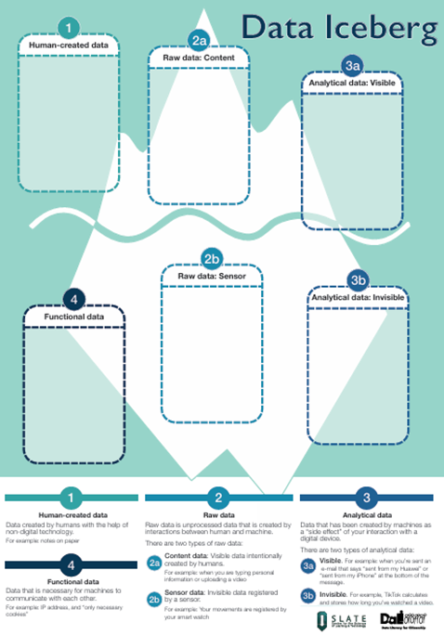
PLAY DATA ICEBERG
Download Data Iceberg PDF: https://edutrust.slateresearch.ai/game-package-english/

Slide 17
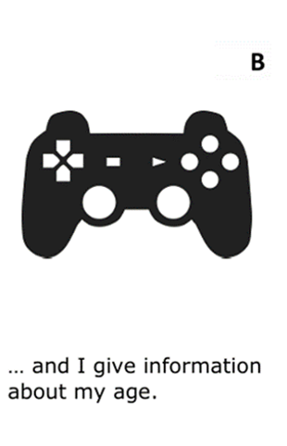

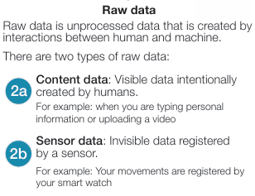
Data Iceberg EXAMPLE

Slide 18

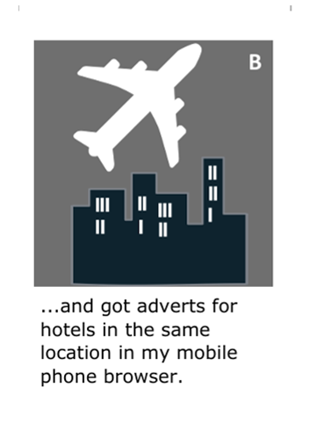
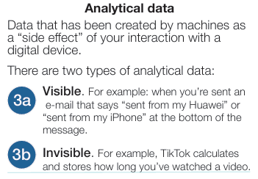
Data Iceberg EXAMPLE
Notes:
Here you can discuss whether the adverts are visible or invisible analytical data. We see ads as visible analytical data - they become visible because they are sent to your mobile based on data that has been analysed and linked to your profile.

Slide 19
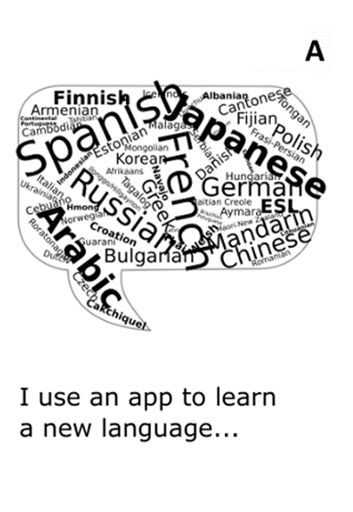
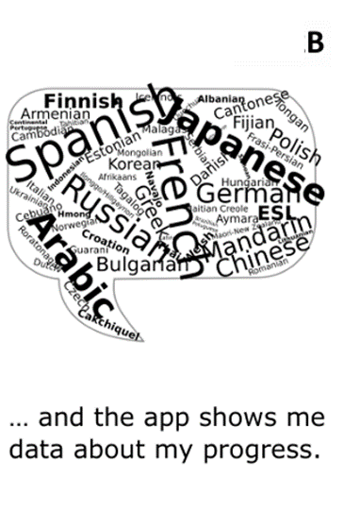
Dataisfjell EKSEMPEL

Slide 20

More resources
Game package: https://edutrust.slateresearch.ai/game-package-english/
Digital Desktop version of DataDelta: https://datadelta.slateresearch.ai/#/
DataDelta PDF: https://edutrust.slateresearch.ai/datadelta-eng/
Data Iceberg PDF: https://edutrust.slateresearch.ai/dataiceberg /
DALI Toolkit (dalicitizens.eu): https://toolkit.dalicitizens.eu/

